Slide 1

S.O.L.I.D.
Open/Closed Principle

Slide 2


History
Originally credited to Bertrand Meyer in 1988
Open for extension, but Closed for modification
Redefined to advocate using abstract base classes
Continually evolving

Slide 3

What does it mean?
Concepts at odds with each other
Don’t change classes
Open for most probable changes

Slide 4

Benefits
Don’t have to change code once it works
Don’t have to rewrite tests
Doesn’t only apply to base classes

Slide 5

How to implement
Abstract base classes!
Inheritance
Protected methods
Virtual and abstract methods

Slide 6
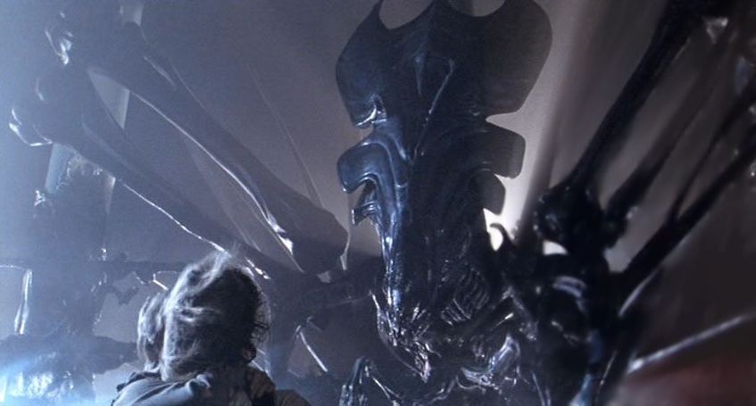
The Kata
Changed requirements for rover
Will be adding missiles
Why does a mars rover need a missile?
This thing →

Slide 7
Step One
Rovers are equipped with 3 missiles and 3 mortars
Missile’s range is 5 spaces
Missile collides with obstacles in the way
Mortar’s range is 10 spaces
Mortar only collides with obstacles at landing
FireProjectile must handle any projectile type
Collisions destroy obstacles
Non-collisions create indestructible obstacles
Code currently works. Needs refactored.
Consider abstract base class for Projectile.
Booleans determining functionality are code smells
If a new projectile is added, then the FireProjectile has to be changed in Rover class
Type ‘runcukes’ from directory

Slide 8
Possible Solution
Projectile
MaxRange
Mars
PositionalAdjustments
IsCollisionDetected
Launch
Mortar
MaxRange
IsCollisionDetected
Missile
MaxRange
IsCollisionDetected

Slide 9
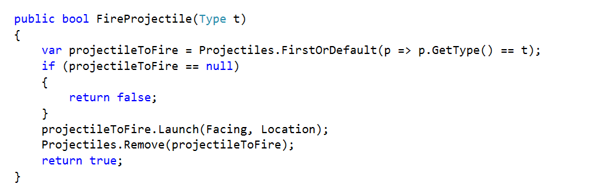
Possible Solution

Slide 10
Step Two
Obstacles created by a projectile must be indestructible
Consider a new type of obstacle
Type ‘runcukes’ from directory

Slide 11
Possible Solution
Obstacle
Location
IsDestructable
Crater
IsDestructable

